Slide 1
S E S S I O N 6
L E V E L 7
w w w . s t u d i o e n g l i s h . c o m

Slide 2

Agenda/ Objectives
S e s s i o n 1
1- Warm up ( 2 mins )
2- learn words related to transport ( p.26 ) ( 30 mins )
3- differentiate between ‘’ʃ- tʃ- dj ‘’. ( p.26 ) ( 15 mins )
4- read for predictions, gist , specific information, guessing words in the context
of ‘’ Top Gear Challenge ‘’ ( p.26 ) ( 25 mins )
5- use comparatives and superlatives adjectives. ( p.28 ) ( 25 mins )
6- speak and give opinion in the context of ‘’ Survive the drive ‘’. ( p.29 ) ( 20 mins )
/ /
studioenglish. c om

Slide 3


Warm up
S e s s i o n 1
u
r
v
i
e
e
r
--------------------------------------------------------------------
S
v
t
h
d
i
v
e
/ /
Survive the drive
studioenglish. c om
Notes:
Ask Students to guess the topic of the lesson. You can give them a hint like ‘’ driver ‘’.

Slide 4

Listen and number the pictures
S e s s i o n 1
/ /
studioenglish. c om

Slide 5

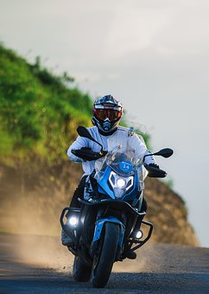
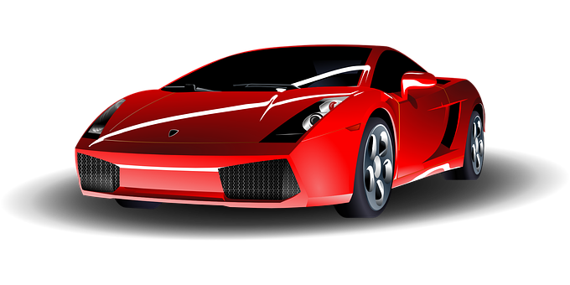
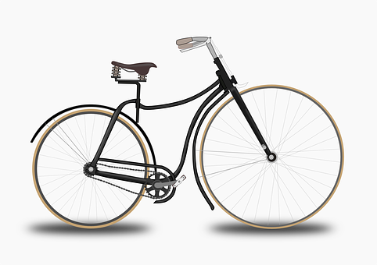
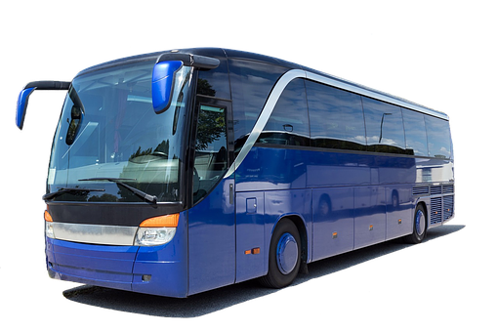
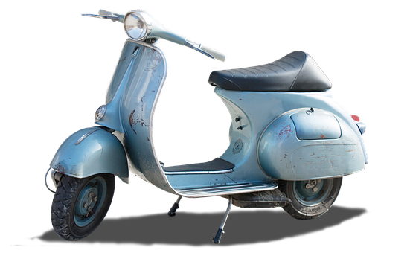
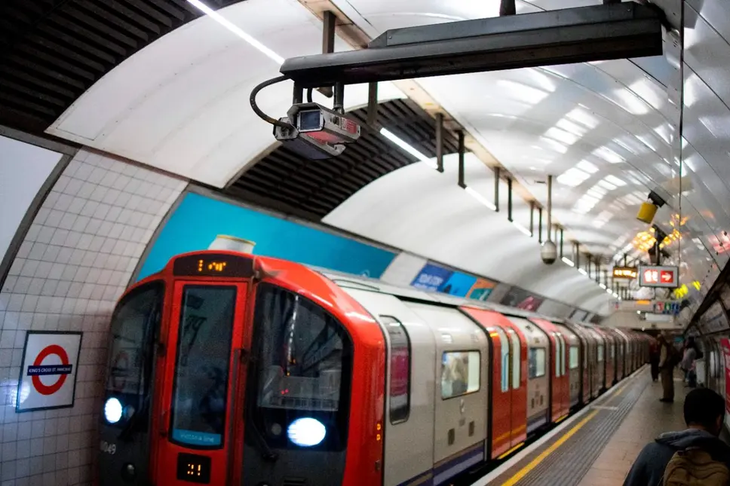
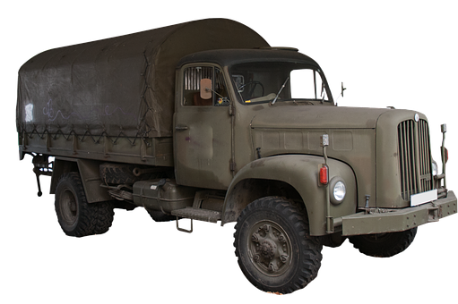
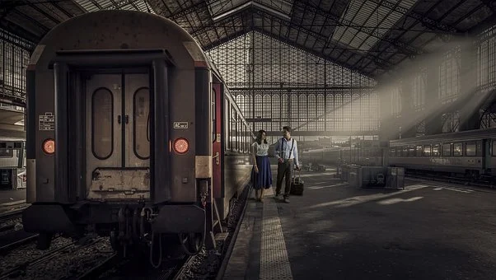
4
3
car
2
8
motorbike
bike
bus
6
1
7
5
lorry
scooter
the underground
train
Notes:
Ss listen to eight forms of transport and number them in order.

Slide 6
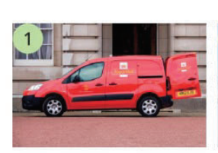
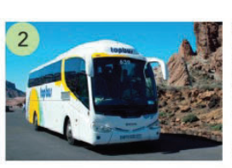
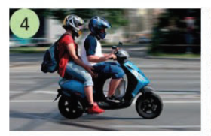
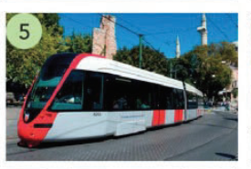
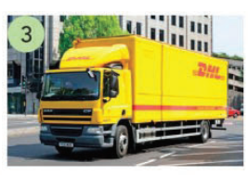
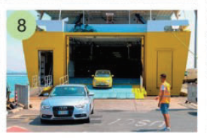
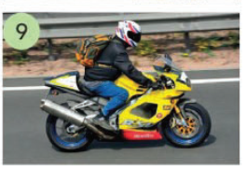
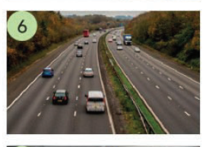
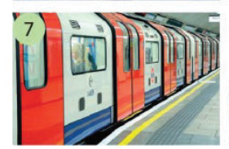
coach
lorry
van
tram
scooter
motorway
motorbike
ferry
the underground
Notes:
Ss match photos with words for public transport and vehicles.

Slide 7

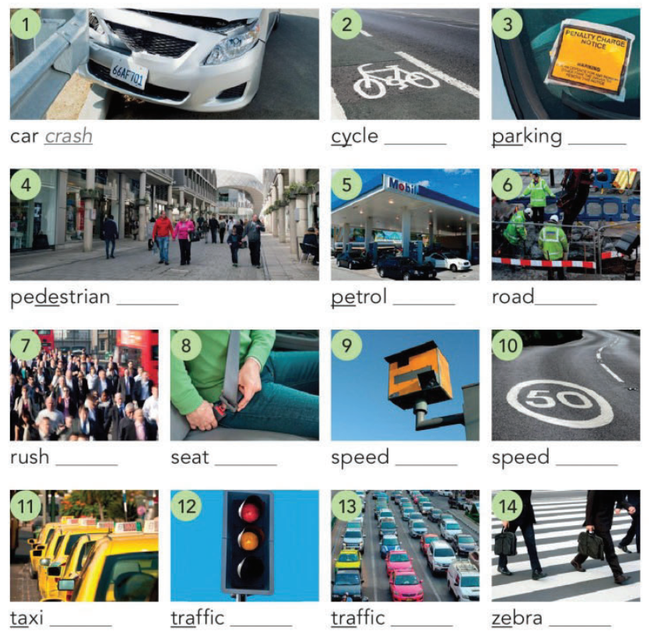
Complete the compound nouns
S e s s i o n 1
belt - camera - crossing
fine - hour - jam - lane -
lights - limit - rank - station - works - zone
lane
fine
zone
station
works
Car
Car
Car
hour
belt
camera
limit
/ /
studioenglish. c om
rank
lights
jam
crossing
Notes:
Ss complete the compound nouns.
Ss listen & check

Slide 8
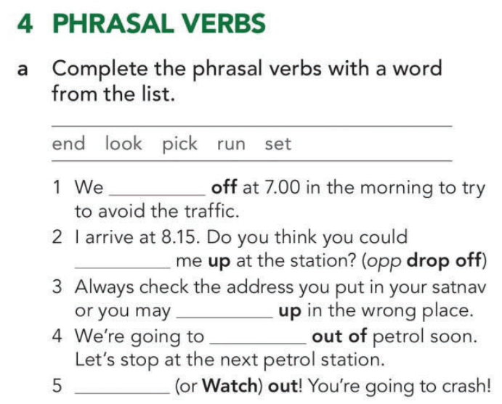
Vocabulary
S e s s i o n 1
set
pick
end
run
/ /
look
studioenglish. c om
Notes:
Ss complete the phrasal verbs with a word from the list.
Ss listen and check.

Slide 9

Conversation
S e s s i o n 1
/ /
studioenglish. c om

Slide 10
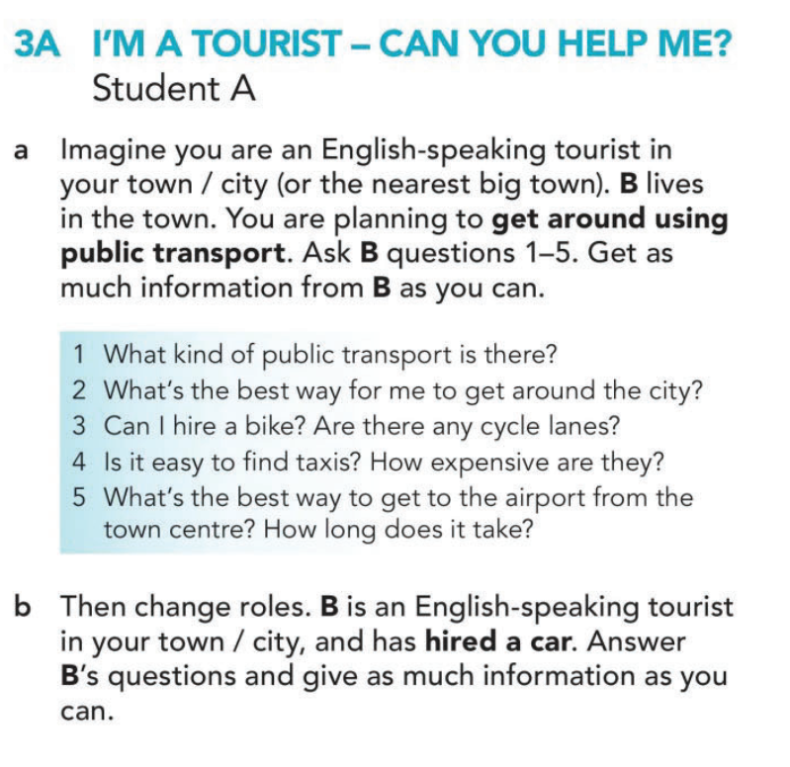
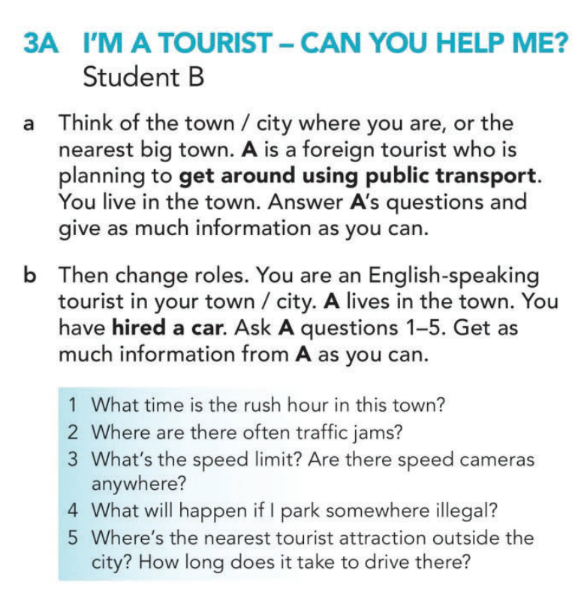
Notes:
In pairs, Ss go to role play communication. ‘’I'm a tourist’’.
Ss switch turns and teacher monitors.
Open class feedback

Slide 11

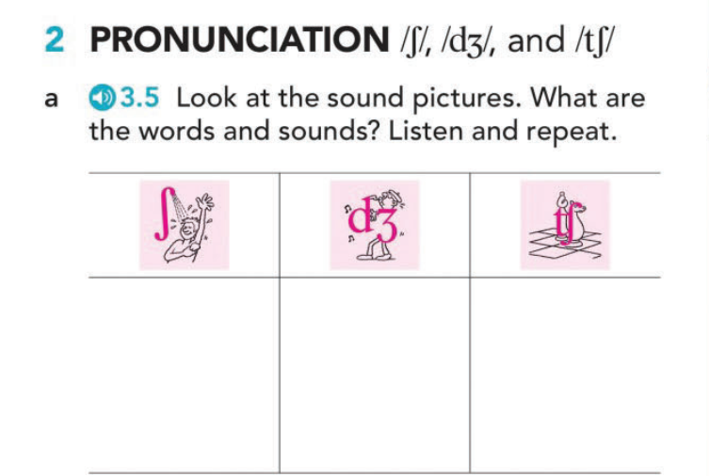

Pronunciation
S e s s i o n 1
shower
jazz
chess
/ /
studioenglish. c om
Notes:
Elicit some words for the three sounds.

Slide 12
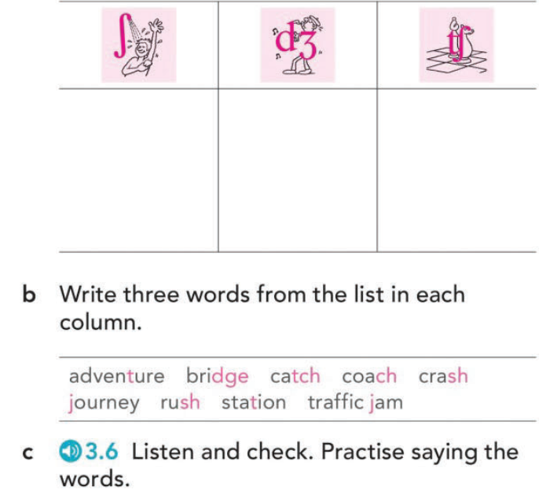
shower
jazz
chess
crash
bridge
adventure
journey
catch
rush
station
traffic jam
coach
Notes:
Ss match the words with the sound pictures
Ss listen and repeat the words.

Slide 13
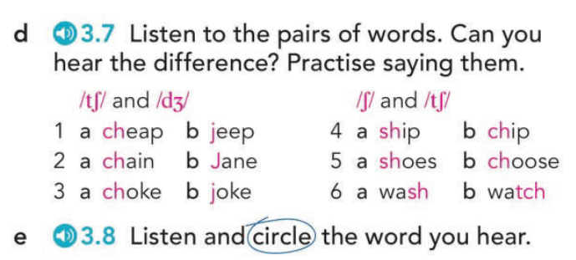
S e s s i o n 1
Notes:
Ss define the mean of the sound pairs.
Ss listen to hear the difference and repeat.

Slide 14
S e s s i o n 1
Listen and write five short sentences or questions.
1- Do you like chips?
2- I’m going to wash it.
3- You choose.
4- Don’t joke about it.
5- Is it cheap?
Notes:
.

Slide 15

Reading
S e s s i o n 1
/ /
studioenglish. c om

Slide 16
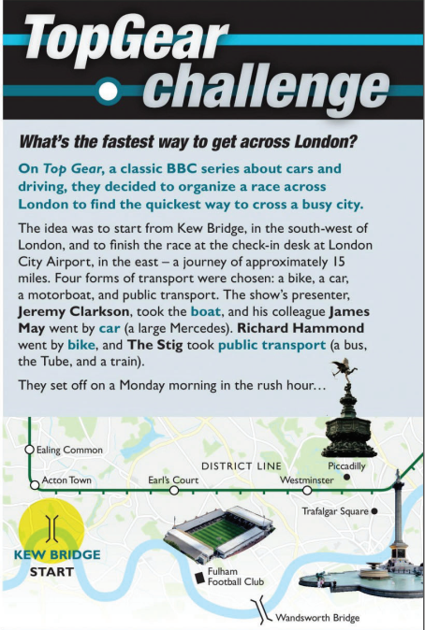
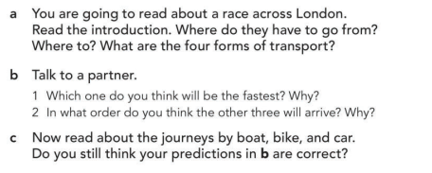
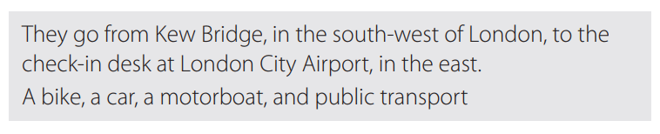
Reading
S e s s i o n 1
/ /
studioenglish. c om
Notes:
Direct Ss to the photo and ask them if they know about the TV program TopGear.
Ask Ss to read the introduction to answer questions about the car race across London such as ‘’ Where do they have to go from ‘’ P.27
In pairs, Ss try to predict the answers of the two questions.

Slide 17
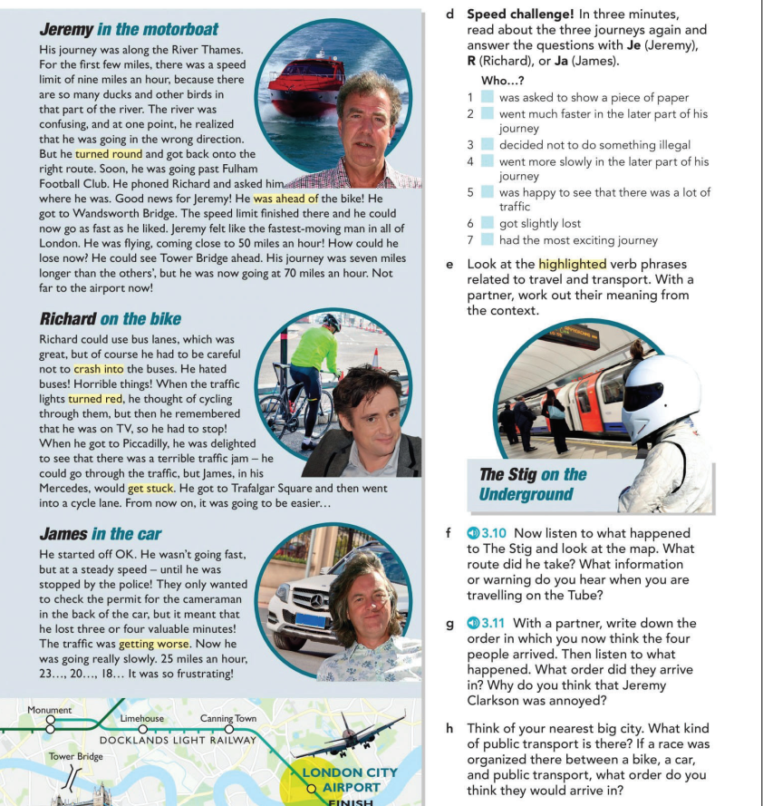
Notes:
Ss read the three paragraphs and check their predictions.

Slide 18
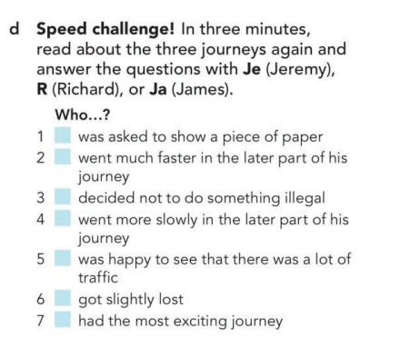
Reading
S e s s i o n 1
ja
je
R
Ja
R
Je
Je
studioenglish. c om
/ /
Notes:
Ss read about the three journeys again to answer questions 1-7.

Slide 19
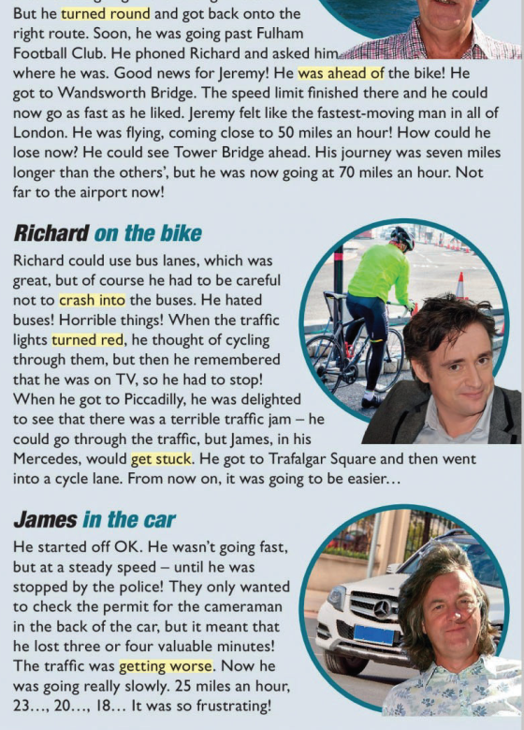
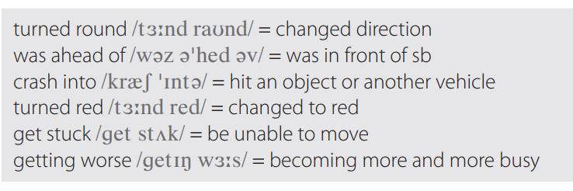
Look at the highlighted verb phrases and work out their meaning?
Notes:
Ss read again to define the highlighted phrases.
Encourage them to use the context to help them guess the meaning.

Slide 20
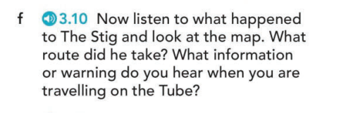
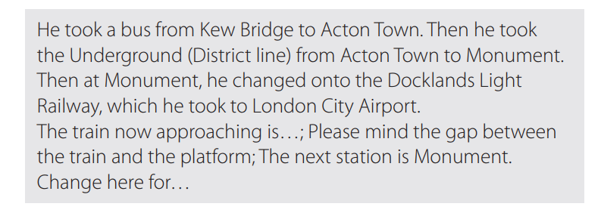
Listening
/ /
studioenglish. c om

Slide 21
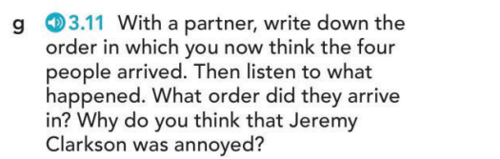

Notes:
Ask Ss to look at the map and to listen to what happened to Stig and what route he took.

Slide 22
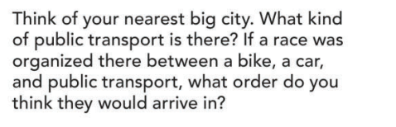
Conversation
S e s s i o n 1
/ /
studioenglish. c om
Notes:
As a whole class, share the kind of public transport in your nearest big city.

Slide 23

Grammar
S e s s i o n 1
/ /
studioenglish. c om

Slide 24
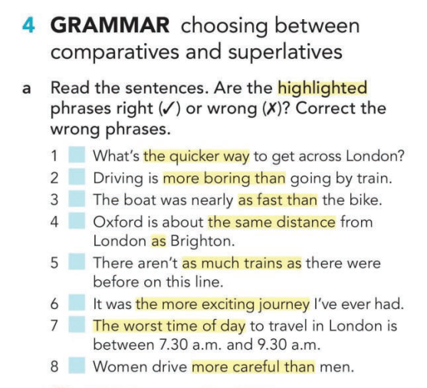


the quickest
as fast as
as many trains as
the most exciting journey
more carefully than
Notes:
Ss read the sentences and decide if the highlighted phrases are right or wrong.

Slide 25

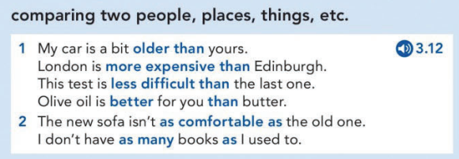
Listen and write.
S e s s i o n 1
/ /
studioenglish. c om

Slide 26

Quiz time
S e s s i o n 1
Click here!
/ /
studioenglish. c om
Notes:
Sts do the quiz about superlative and comparative adjectives.

Slide 27
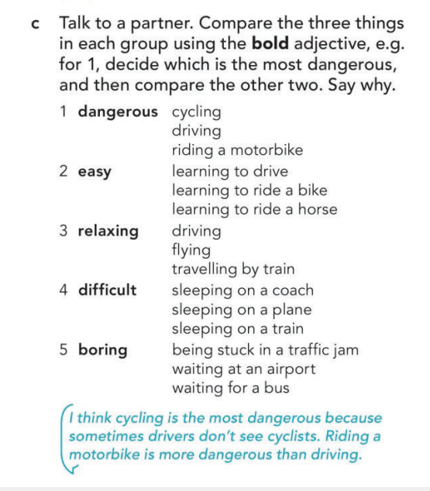
Conversation
S e s s i o n 1
/ /
studioenglish. c om
Notes:
In pairs, ask Ss to make a superlative sentence using the giving adjective, i.e. Cycling is the most dangerous. Then they must compare the other two remaining, i.e. Riding a motorcycle is more dangerous than driving.
Open feedback

Slide 28
Conversation
S e s s i o n 1
/ /
studioenglish. c om

Slide 29
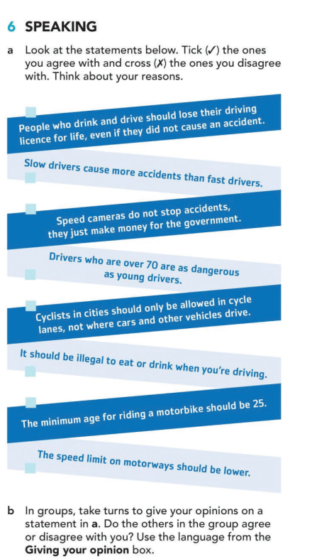

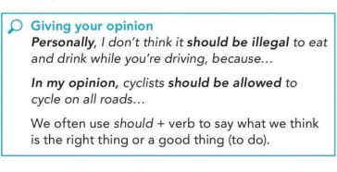
Notes:
Ss read the statements to decide if they agree or disagree with them and think of their reasons.
Ss work in groups and take turns to give their own opinions and reasons.
Encourage Ss to use the expressions in the box.
Teacher monitors and takes notes.
Open class feedback

Slide 30

Exit ticket
S e s s i o n 1
Click here!
/ /
studioenglish. c om
Notes:
Sts answer a quiz about transportation.

Slide 31

T H A N K S

